Slide 1
Instant OS Updates via Userspace Checkpoint-and-Restart
Sanidhya Kashyap, Changwoo Min, Byoungyoung Lee,
Taesoo Kim, Pavel Emelyanov
Dong-su Lee

Slide 2
Summary
Topic
OS update
user routinely update their operating systems
Problem
to updates OS, users must reboot their system
reboot system result in unavoidable downtime
Solution
employs a userspace checkpoint-and-restart mechanism
Instant OS update(KUP)
Significance
they can updates kernel without any kernel modifications

Slide 3
Introduction
OS update
OS have be come complex and more prone to problem,
OS updates are necessary to promptly mitigate problem.
e.g. to fix bugs, add a new set of features, etc.
Checkpoint and Restart
is a technique to add fault tolerance into computing systems
consists of saving a snapshot of the app's state then can restart
Restart
failure
checkpoint

Slide 4
Existing practices for OS updates
Limitation
to update users must reboot their system
resulting in unavoidable downtime
Dynamic Kernel Patching (e.g., kpatch, ksplice)
directly applies patches to the running kernel
Problem: only support minor patches
Rolling Update (e.g., Google, Facebook, etc) for large-sacle system
apply an update to a small group of machines then update the others
Problem: inevitable downtime and requires careful planning

Slide 5
Problems of typical OS update
Memcached
OS
OS
2~10m of downtime
2~3h of downtime
Stop service
Soft reboot
Start service
Memcached
New OS
New OS

Slide 6
Contributions
Instant OS update
design a simple, yet robust update mechanism by using app C/R
show effectiveness by providing an in-depth analysis with full SW stack
devise, implement and evaluate a safe fallback mechanism
※ app – application
※ C/R – Checkpoint and Restart

Slide 7
Overall of KUP
Memcached
Memcached
OS
OS
2~10m of downtime
Checkpoint
In-kernel
switch
Restart
Memcached
Memcached
New OS
New OS

Slide 8
Approach
KUP’s life cycle
1) checkpoints the running applications
2) switches to the updated OS, In-kernel switch
3) restores the suspended applications
KUP’s life cycle
1
Checkpoint
2
In-kernel switch
3
Restore

Slide 9
Checkpointing applications
consist of two step
takes a snapshot of running applications
stored in persistent storage
take snapshot
snapshot is made up of process states(
consisting of their memory space and internal states in the kernel
e.g., code/data sections and stack/heap, states of sockets , etc.
stored in persistent storage
KUP can fetch it after switching to the updated OS

Slide 10
Switching kernel
consist of two step
load and switch kernel
boots up and relaunches
load and switch
loads the new kernel(new version) binary to its memory
switches its running kernel(old version) to the new one(new version)
boots up and relaunches
new kernel quickly boots up by skipping most of the hardware initialization routine(because it were already initialized)
The system management daemon relaunches the required system services after the kernel initialization

Slide 11
Restoring applications
consist of two step
run the new updated kernel
reconstructs the states inside the kernel
running the new kernel
running the newly updated kernel with its system services
reconstructs the states inside the kernel
reconstructs the processspecific states inside the kernel
then restarts the app
Safe fallback
allows for automatic fallback to the previous OS state

Slide 12
Optimization
reducing the downtime
by using incremental checkpoint
leverage on-demand restore
issues
using above two methods occurs another problem
thus, KUP apply FOAM and PPP
※ FOAM - file offset-based address mapping
※ PPP – persistent physical pages

Slide 13
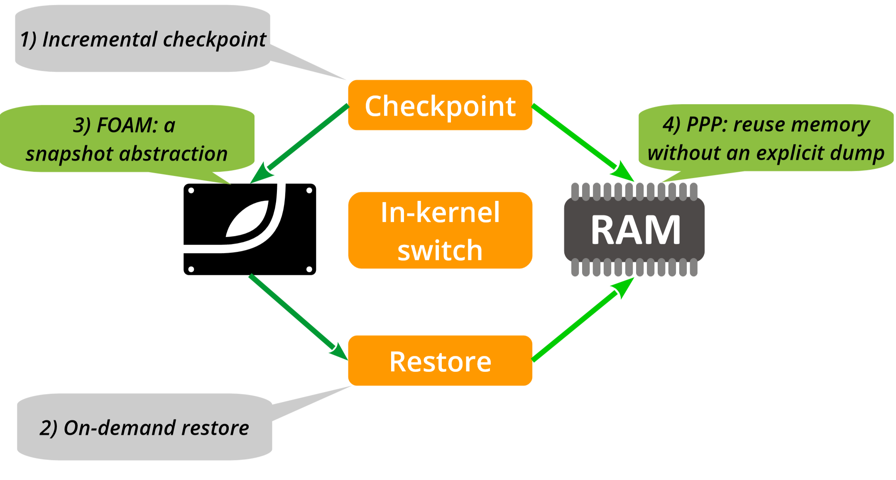
Optimization

Slide 14
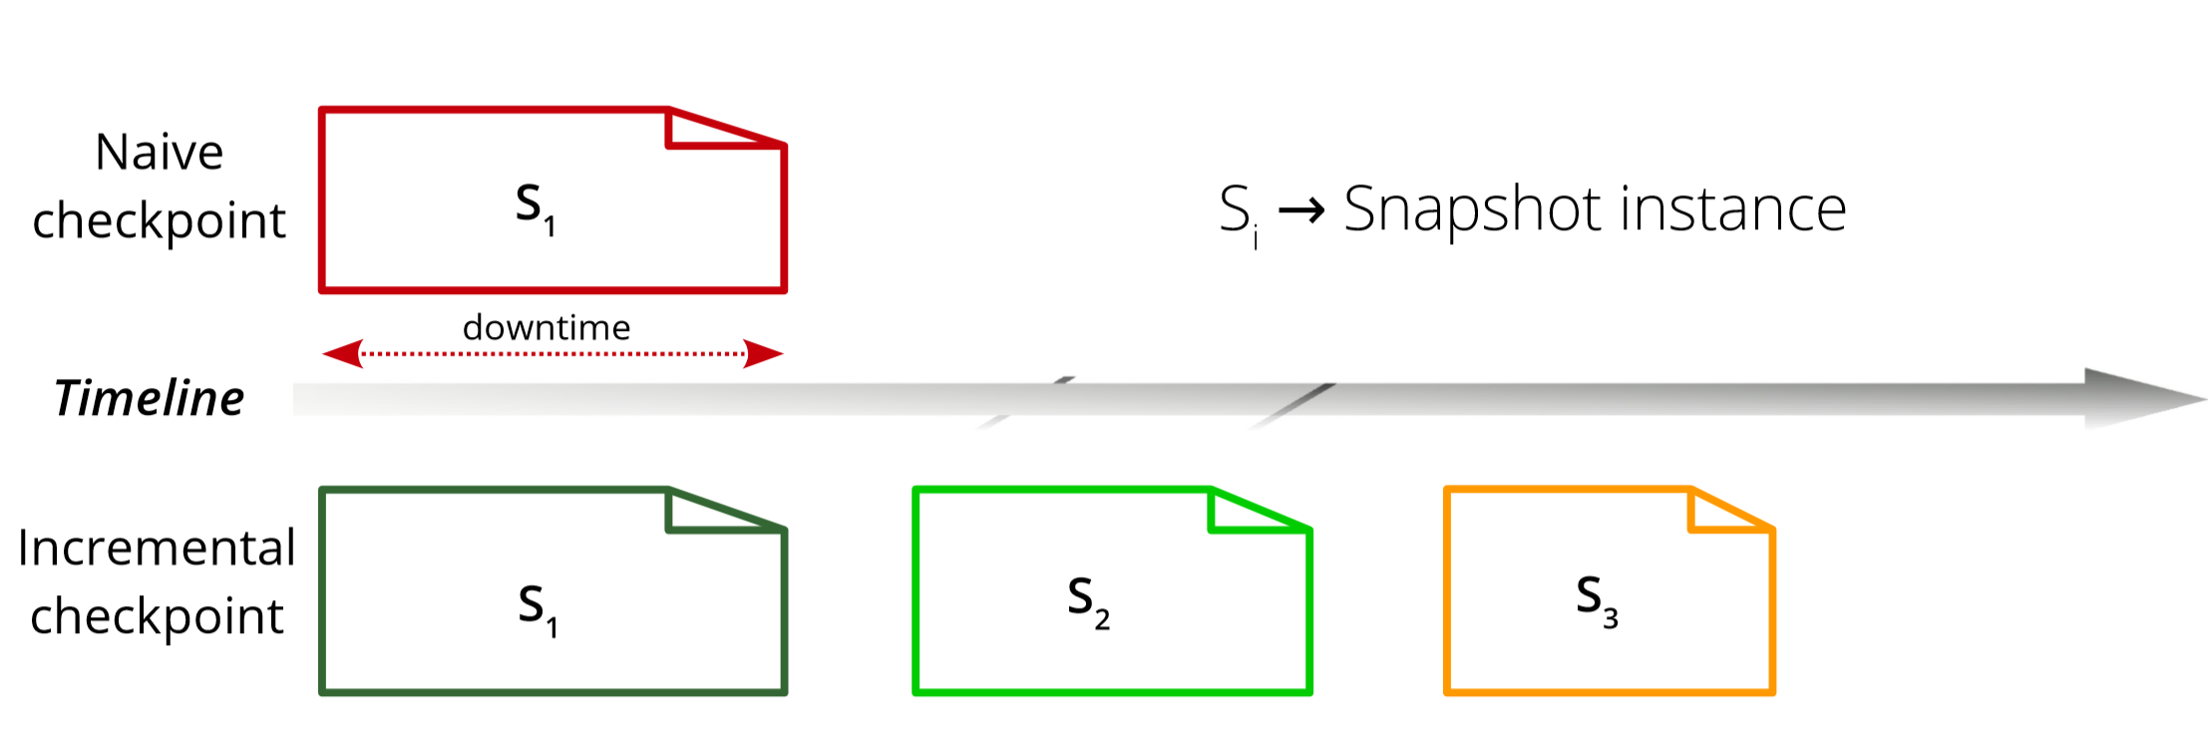
incremental checkpoint
reduces downtime (up to 83.5%)
problem
Multiple snapshots increase the restore time

Slide 15
On-demand restore
rebind the memory once the application accesses it
Only map the memory region with snapshot and restart the application
decreases the downtime (up to 99.6%)
problem
Incompatible with incremental checkpoint

Slide 16
Problem for apply both techniques
during restore, need to map each pages individually
Individual lookups to find the relevant pages
Individual page mapping to enable on-demand restore
increases the restoration downtime (42.5%)

Slide 17
File offset-based address mapping (FOAM)
Flat address space representation for the snapshot
One-to-one mapping between the address space and the snapshot
No explicit lookups for the pages across the snapshots
A few map operations to map the entire snapshot with address space
Use sparse file representation
Rely on the concept of holes supported by modern file systems
Simplifies incremental checkpoint and on-demand restore

Slide 18
Persist physical pages (PPP)
reserve virtual-to-physical mapping information
static instrumentation of the OS binary
inject our own memory reservation function, then further boot the OS
handle page-faults for the restored application
dynamic kernel instrumentation
inject our own page fault handler function for memory binding
Avoid redundant data copy across reboot

Slide 19
Evaluation
How effective is KUP’ approach?
What is the effective performance of each technique during the update?

Slide 20
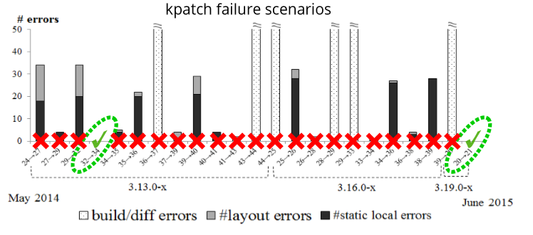
Evaluation
OS : Ubuntu, KUP vs kpatch
KUP supports 23 minor/4 major updates(v3.17 – v4.1)
kpatch an only update 2 versions

Slide 21
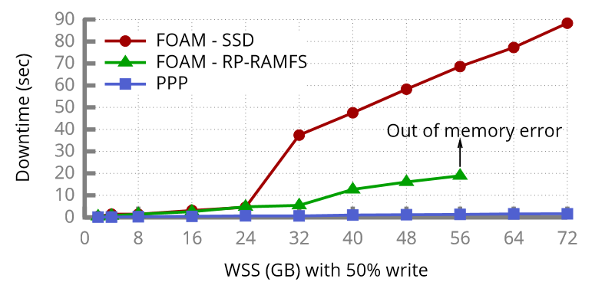
Evaluation
FOAM on SSD slow
FOAM on RP-RAMFS space inefficient

Slide 22
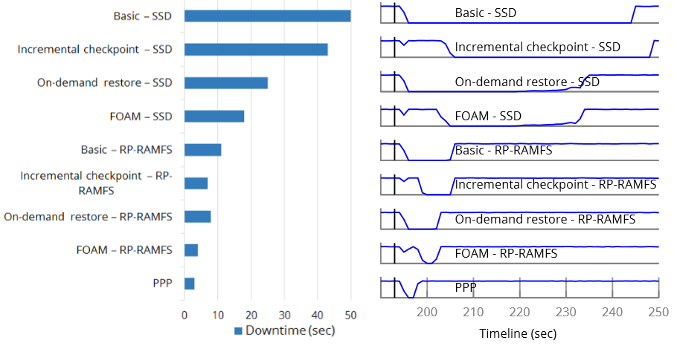
Evaluation
PPP has the least degradation
Storage also affects the performance

Slide 23
limitation
KUP does not support C/R all socket implementations
TCP/UDP and netlink are supported
KUP’s FOAM is still sensitive to the number of cache to-disk writes
failure during restoration
System call is removal or interface modification

Slide 24
conclusion
KUP : a simple update mechanism with application C/R
employs various techniques :
FOAM, New data abstraction for app C/R
Fast in-kernel switching technique
PPP, reuse memory without an explicit dump
KUP do not support all socket and has failure
PPP shows least performance degradation(0.68% over the period of 300) after being restored
first work that realizes swift kernel updates without modifying any kernel source.

